Slide 1
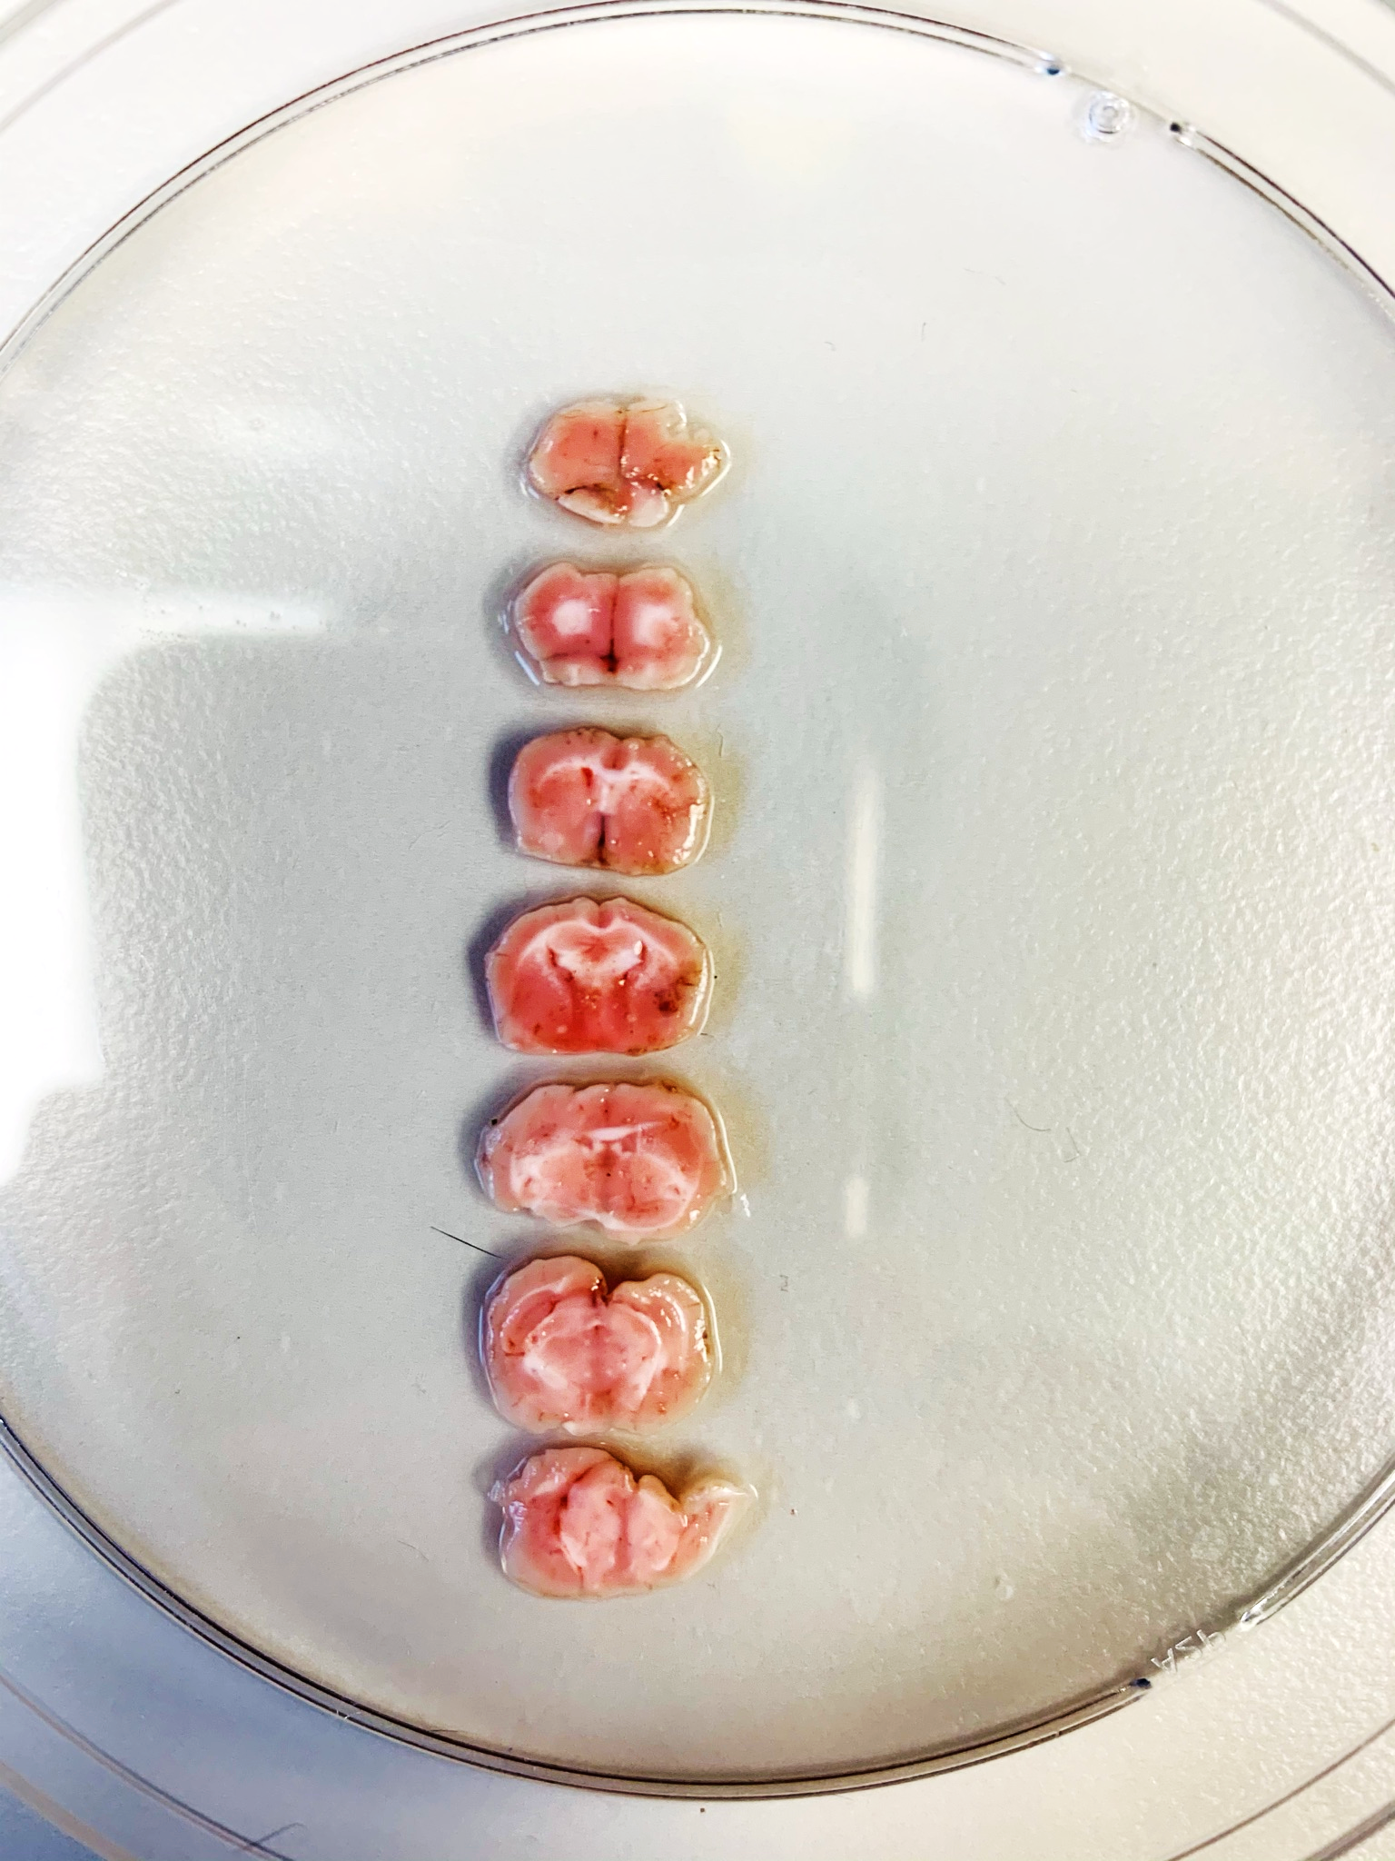
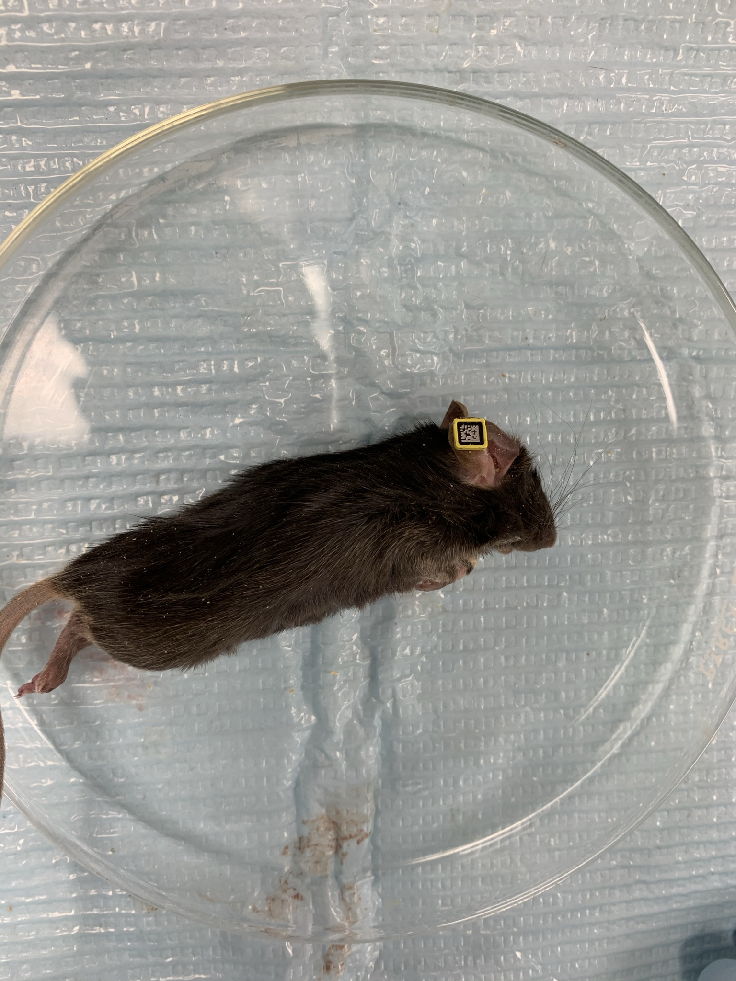
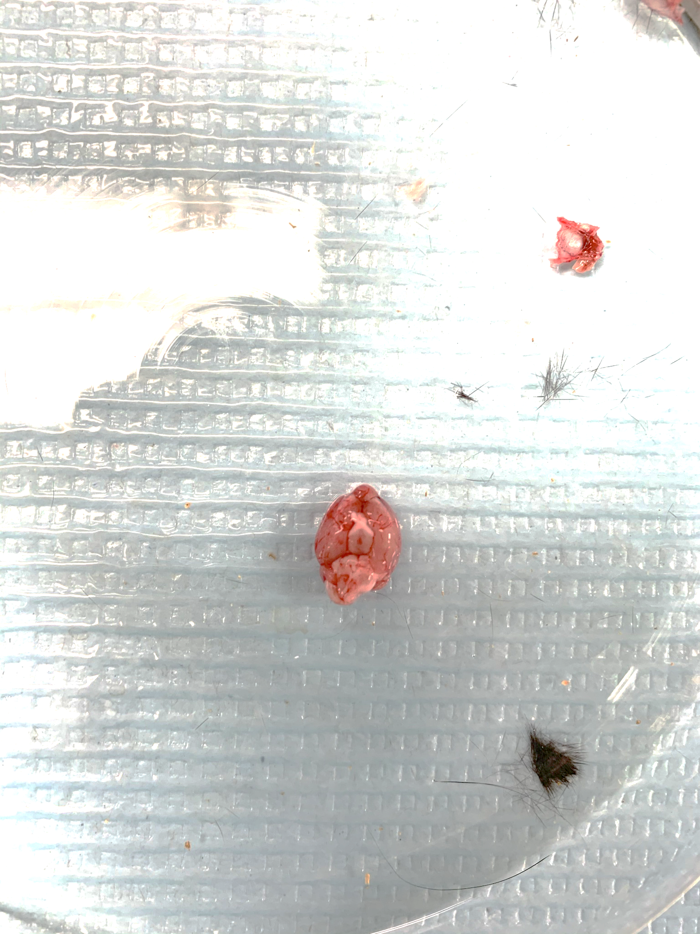
Mouse ID: AM5396
Date of surgery: 10/6/2020
Date on which found dead: 10/18/2020

